Slide 1
Computer Networks
“Introduction - 2”
Asst. Lect. Ahmed M. Jasim
Computer Department - College of Engineering
University of Diyala
2017

Slide 2
COMPUTER NETWORK TOPOLOGIES
1- BUS Topology
Bus topology is a network type in which every computer and network device is connected to single cable. When it has exactly two endpoints, then it is called Linear Bus topology. Bus topology may have problem while multiple hosts sending data at the same time. Therefore, Bus topology either uses CSMA/CD technology or recognizes one host as Bus Master to solve the issue.

Slide 3
COMPUTER NETWORK TOPOLOGIES
Features of Bus Topology
1- It transmits data only in one direction.
2- Every device is connected to a single cable
3- It is one of the simple forms of networking where a failure of a device does not affect the other devices. But failure of the shared communication line can make all other devices stop functioning.

Slide 4
COMPUTER NETWORK TOPOLOGIES
Advantages of Bus Topology
1- It is cost effective.
2- Cable required is least compared to other network topology.
3- Used in small networks.
4- It is easy to understand.
5- Easy to expand joining two cables together.
Disadvantages of Bus Topology
1- Cables fails then whole network fails.
2- If network traffic is heavy or nodes are more the performance of the network decreases.
3- Cable has a limited length.
3- It is slower than the ring topology.

Slide 5
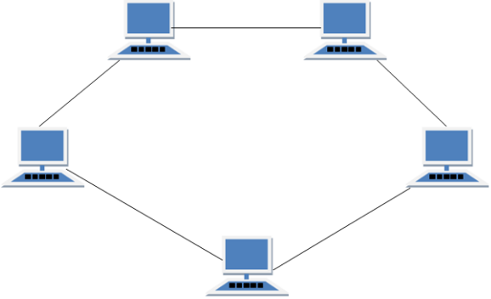
COMPUTER NETWORK TOPOLOGIES
2- RING Topology
It is called ring topology because it forms a ring as each computer is connected to another computer, with the last one connected to the first. Exactly two neighbors for each device.

Slide 6
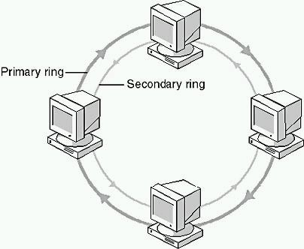
COMPUTER NETWORK TOPOLOGIES
Features of Ring Topology
1- A number of repeaters are used for Ring topology with large number of nodes
2- The transmission is unidirectional, but it can be made bidirectional by having tow connections between each Network Node, it is called Dual Ring Topology.
3- In Dual Ring Topology, two ring networks are formed, and data flow is in opposite direction in them. Also, if one ring fails, the second ring can act as a backup, to keep the network up.
4- Data is transferred in a sequential manner that is bit by bit. Data transmitted, has to pass through each node of the network, till the destination node.

Slide 7
COMPUTER NETWORK TOPOLOGIES
Advantages of Ring Topology
1-Transmitting network is not affected by high traffic or by adding more nodes, as only the nodes having tokens can transmit data.
2- Cheap to install and expand
Disadvantages of Ring Topology
1-Troubleshooting is difficult in ring topology.
2- Adding or deleting the computers disturbs the network activity.
3- Failure of one computer disturbs the whole network

Slide 8
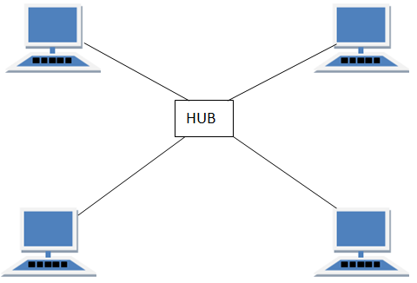
COMPUTER NETWORK TOPOLOGIES
3- STAR Topology
All hosts in Star topology are connected to a central device, known as hub device, using a point-to-point connection. That is, there exists a point to point connection between hosts and hub. The hub device can be any of the following:
Layer-1 device such as hub or repeater Layer-2 device such as switch or bridge
Layer-3 device such as router or gateway.

Slide 9
COMPUTER NETWORK TOPOLOGIES
Features of Star Topology
1- Every node has its own dedicated connection to the hub.
2- Hub acts as a repeater for data flow.
3- Can be used with twisted pair, Optical Fiber or coaxial cable.
Advantages of Star Topology
1- Fast performance with few nodes and low network traffic.
2- Hub can be upgraded easily.
3- Easy to troubleshoot.
4- Easy to setup and modify.
5- Only that node is affected which has failed, rest of the nodes can work smoothly.
Disadvantages of Star Topology
1- Cost of installation is high.
2- Expensive to use.
3- If the hub fails, then the whole network is stopped because all the nodes depend on the hub.
4- Performance is based on the hub that is it depends on its capacity

Slide 10
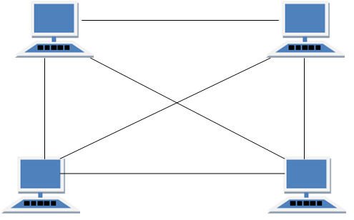
COMPUTER NETWORK TOPOLOGIES
4- MESH Topology
It is a point-to-point connection to other nodes or devices. All the network nodes are connected to each other. Mesh has n(n-1)/2 physical channels to link n devices.
There are two techniques to transmit data over the Mesh topology, they are:
A- Routing
B- Flooding

Slide 11
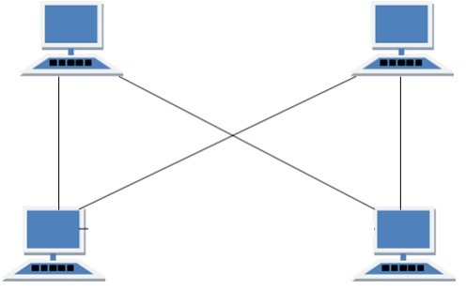
COMPUTER NETWORK TOPOLOGIES
Types of Mesh Topology
1- Partial Mesh Topology: In this topology some of the systems are connected in the same fashion as mesh topology but some devices are only connected to two or three devices.
2- Full Mesh Topology: Each and every nodes or devices are connected to each other.

Slide 12
COMPUTER NETWORK TOPOLOGIES
Features of Mesh Topology
1- Fully connected.
2- Robust.
3- Not flexible.
Advantages of Mesh Topology
1- Each connection can carry its own data load.
2- It is robust.
3- Fault is diagnosed easily.
4- Provides security and privacy.
Disadvantages of Mesh Topology
1- Installation and configuration is difficult.
2- Cabling cost is more.
3- Bulk wiring is required.

Slide 13
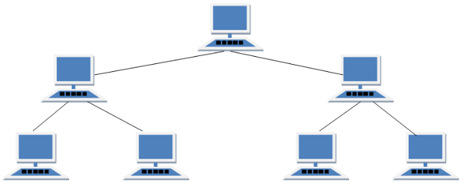
COMPUTER NETWORK TOPOLOGIES
5- TREE Topology
It has a root node and all other nodes are connected to it forming a hierarchy. It is also called hierarchical topology. It should at least have three levels to the hierarchy.

Slide 14
COMPUTER NETWORK TOPOLOGIES
Features of Tree Topology
1- Ideal if workstations are located in groups.
2- Used in Wide Area Network (WAN).
Advantages of Tree Topology
1- Extension of bus and star topologies.
2- Expansion of nodes is possible and easy.
3- Easily managed and maintained.
4- Error detection is easily done.
Disadvantages of Tree Topology
1- Heavily cabled.
2- Costly.
3- If more nodes are added maintenance is difficult.
4- Central hub fails, network fails.

Slide 15
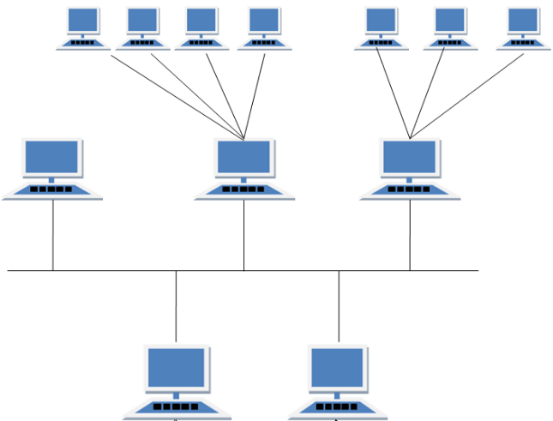
COMPUTER NETWORK TOPOLOGIES
6- HYBRID Topology
A network structure whose design contains more than one topology is said to be hybrid topology. Hybrid topology inherits merits and demerits of all the incorporating topologies.

Slide 16
COMPUTER NETWORK TOPOLOGIES
Features of Hybrid Topology
1- It is a combination of two or more of topologies
2- Inherits the advantages and disadvantages of the topologies included
Advantages of Hybrid Topology
1- Reliable as Error detecting and troubleshooting is easy.
2- Effective.
3- Scalable as size can be increased easily.
4- Flexible.
Disadvantages of Hybrid Topology
1- Complex in design.
2- Costly.

Slide 17
THANK YOU

